Slide 1

SQL
Lecturers: Alexander Ivanoff, Heather Chen
Wednesday, April 26, 2017

Slide 2
The Structured Query Language (SQL)
What does SQL look like?
SELECT ptype, AVG(cost)
FROM products
WHERE cost > 50
GROUP BY ptype
ORDER BY cost
Recursive
You can always add new clauses
KEYWORDS are often written in caps but only for style consistency
Commas separate multiple items/queries of a clause
Each line in the statement to your left is a clause
What you want in your table
What table is your data from?
A “filter” for data in your table

Slide 3
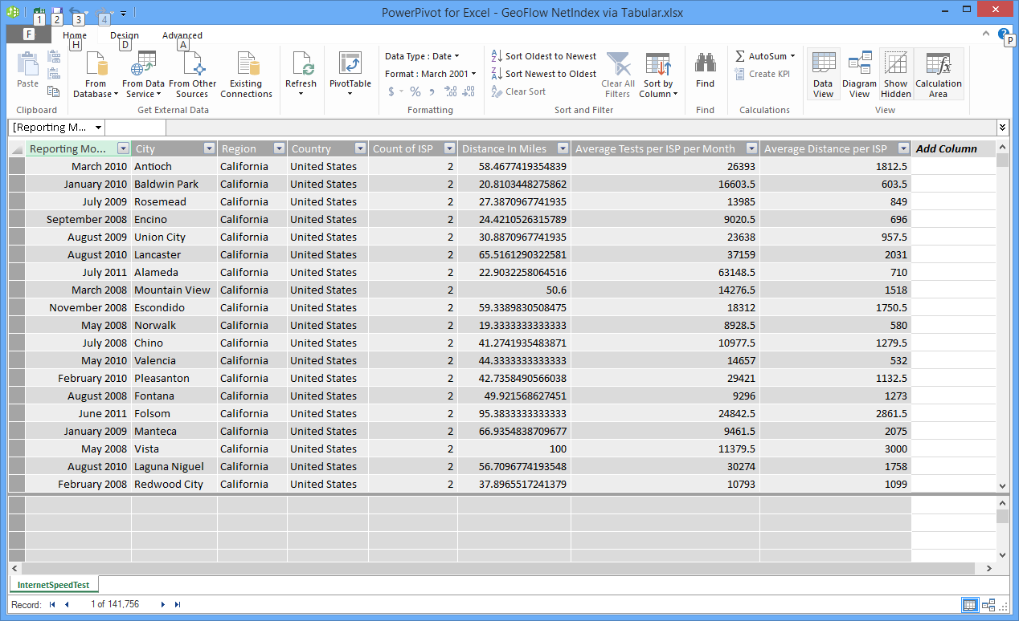
Tabular Model
How to recognize it:
All information for a single record is contained in a row for that record
Pros:
Easy to read
Cons:
Sparse values
Takes up more space/is slower

Slide 4
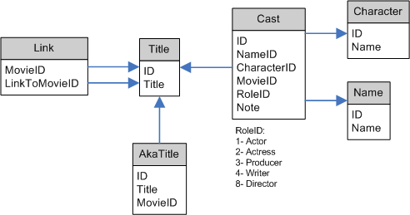
Relational Model
How to recognize it:
Information is spread across multiple relational schema
Pros:
More efficient
Schema represent real-world relationships
Cons
Requires complex db system to process

Slide 5
Setting up
Download SQLite Studio https://sqlitestudio.pl/index.rvt
Download database (Twitter US Airline Sentiment) https://www.kaggle.com/crowdflower/twitter-airline-sentiment
Unzip cpgz database file in Terminal using the command:
unzip location/of/zipfile.zip
Upload database into SQLite Studio

Slide 6
CSVs versus Databases
You may have noticed that there was a CSV file as well as a database (.sqlite) file in the download. CSV files are commonly found to store and display data in a table format, such as what you’ve seen on Excel. We need to use the SQLite file in SQLite studio because the CSV file simply stores the data but does not have additional capacities to handle and optimize queries
Databases can handle querying tasks, so you don't have to walk over files manually. Databases can handle very complicated queries.
Databases can handle indexing tasks, so if tasks like get record with id = x can be VERY fast
Databases can handle multiprocess/multithreaded access.
Databases can handle access from network
Databases can watch for data integrity
Databases can update data easily (see 1) )
Databases are reliable
Databases can handle transactions and concurrent access
Databases + ORMs let you manipulate data in very programmer friendly way.

Slide 7
SQL Syntax

Slide 8
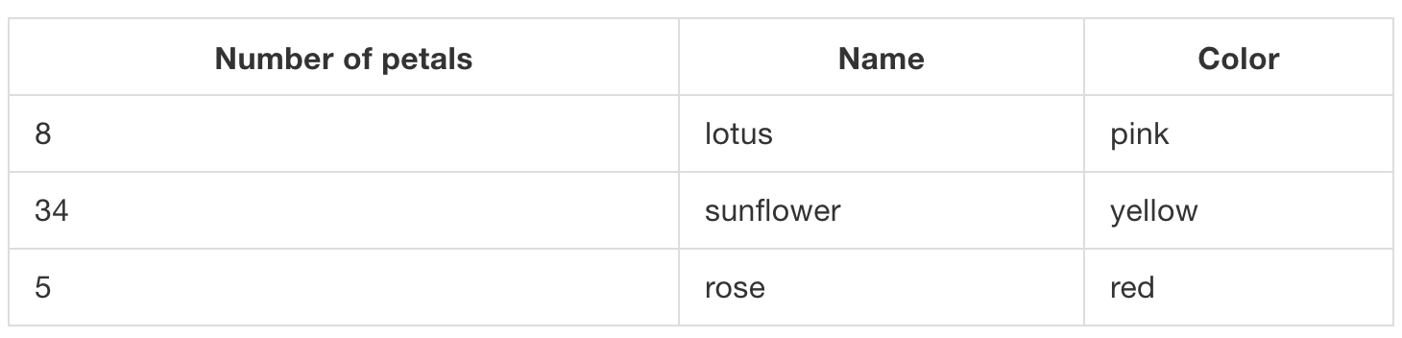
Schemas
Need to clearly identify the tables we’re working with and the structure of the data
SQL requires defined schemas, (a structure) for databases.

Slide 9
Schemas
This table is named flowers and has three columns: Number of petals, Name, and Color.
Every entry that goes into this table must be in the format “Number of petals, Name, Color” and must follow the type specified by that column. Number of petals is an integer, and Name and Color are both strings.

Slide 10
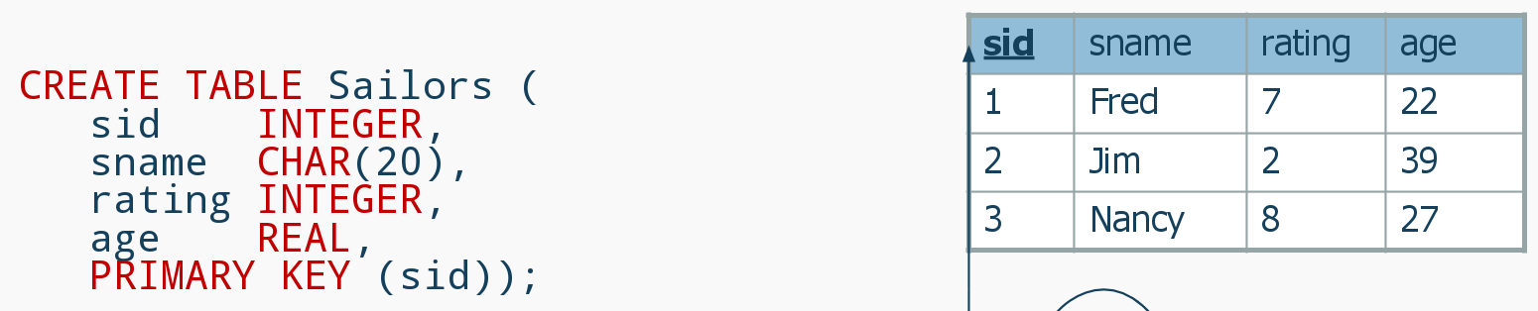
Making tables

Slide 11
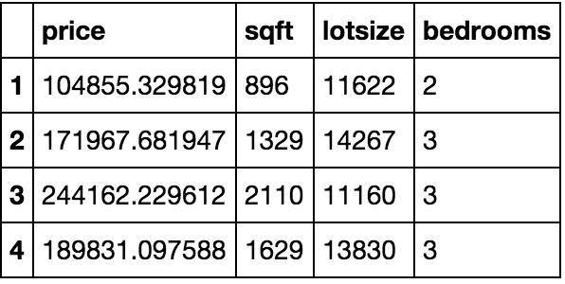
SELECT … FROM ...
We don’t always want all the columns from a table (data can be big!), so we use SELECT and FROM to declare what we want
Selects only the specified columns from the specified tables
Here if we only want to see price and number of bedrooms, we will write:
SELECT price, bedrooms FROM housing;

Slide 12
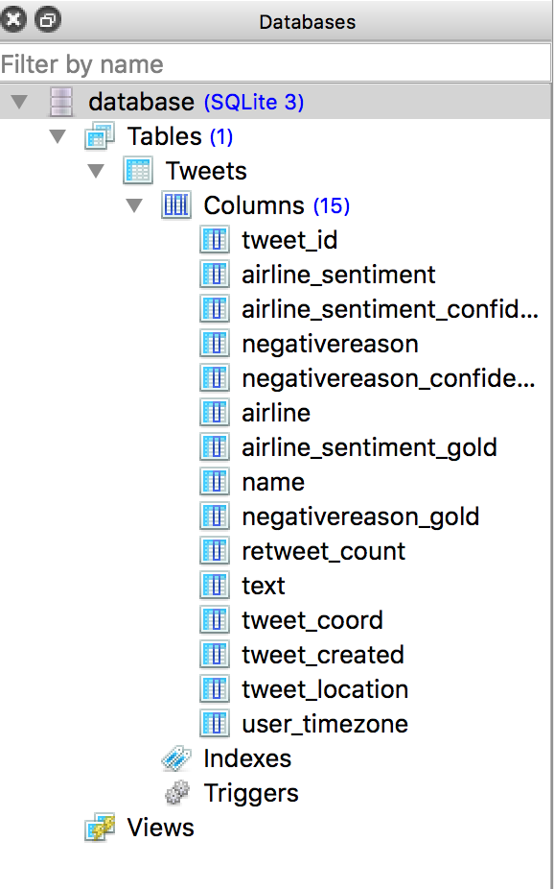
Understanding our database
The table name is Tweets
Column names are all the titles listed underneath “Columns”

Slide 13
Practicing SELECT
It’s time to start working with our Twitter Airline Sentiment database!
Exercise: Write a query to select the columns tweet_id, airline_sentiment, airline, and tweet_created
SELECT tweet_id, airline_sentiment, airline, tweet_created
FROM Tweets;

Slide 14
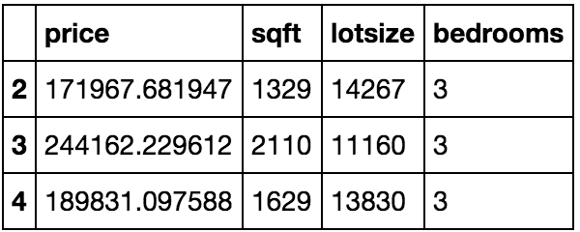
WHERE …
Only returns records for which the boolean/filter is true
> , >= , = , < , <= , <>
e.g.
SELECT * FROM houses
WHERE bedrooms = 3;

Slide 15
Practicing WHERE
Write a query to select the text of tweets where the airline is United
Write a query to select the retweet count and text of the negative tweets
SELECT text FROM Tweets WHERE airline = “United”;
SELECT retweet_count, text FROM Tweets WHERE airline_sentiment = “negative”;

Slide 16
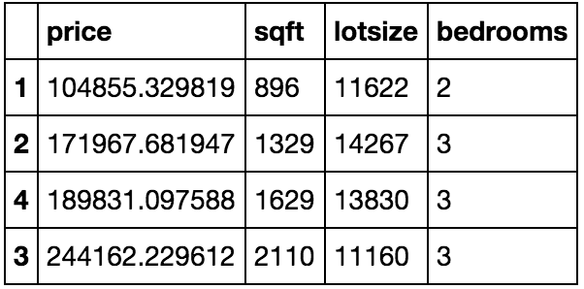
ORDER BY … (ASC/DESC)
Sorts results in ASCending or DESCending order according to the column specified
Ascending/smallest first is default, meaning if you want results in ascending order, you don’t need to specify
If you want results in decreasing order, you must add DESC at the end of the ORDER BY clause
E.g.
SELECT * FROM houses
ORDER BY sqft;

Slide 17
Practicing ORDER BY
Exercise: Write a query that selects airline sentiment and airline sentiment confidence for all tweets about US Airways, sorted by decreasing highest confidence
SELECT airline_sentiment, airline_sentiment_confidence
FROM Tweets
WHERE airline = “US Airways”
ORDER BY airline_sentiment_confidence DESC;

Slide 18
Aggregates

Slide 19
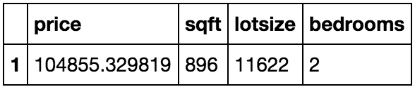
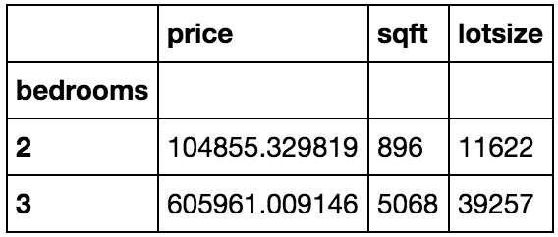
Aggregate:
Def: A whole formed by combining several (typically disparate) elements
GROUP BY bedrooms
SUM(price), SUM(sqft), SUM(lotsize)
These are aggregated

Slide 20
GROUP BY …
GROUP BY defaults to returning a count for each aggregated column but can also be specified with a different aggregate function.
SUM, COUNT, AVG, MIN, MAX
And you can write your own!
(P.S. You can only apply aggregate functions to non-grouped columns)

Slide 21
Practice GROUPING
Exercise: Write a query that returns a table with a row for each airline with the count of the tweets related to it.
SELECT airline, COUNT(*)
FROM Tweets
GROUP BY airline;

Slide 22
HAVING ...
Having has the same functionality as WHERE but is used in the aggregate, not final result
<= HAVING bedrooms = 2
These are aggregated
<= HAVING bedrooms = 3

Slide 23
Practice with GROUP BY… HAVING
Find the average confidence for each airline’s various rating levels that have at least one retweet. Your table should have the airline name, sentiment, and the average confidence level.
SELECT airline, airline_sentiment, AVG(airline_sentiment_confidence) as c
FROM Tweets
WHERE retweet_count > 0
GROUP BY airline, airline_sentiment
HAVING c > .7;

Slide 24
Joins

Slide 25

https://www.codeproject.com/KB/database/Visual_SQL_Joins/Visual_SQL_JOINS_orig.jpg
Notes:
There’s a ton of different joins! But the default is inner join

Slide 26
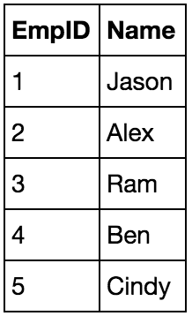
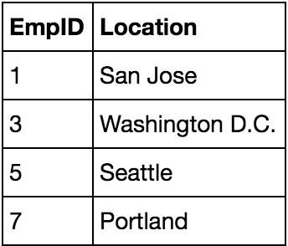
Inner Join
This is the DEFAULT join. Takes only values that are in both tables.
Table name: employees
Table name: locations

Slide 27
SQL Syntax for Joins
The following SQL code matches IDs from table1 and table2 and gives you column2 from table1 and column3 from table2. (One row for each unique ID)
SELECT table1.ID, table1.column2, table2.column3
FROM table1
JOIN table2 ON table1.ID = table2.ID

Slide 28
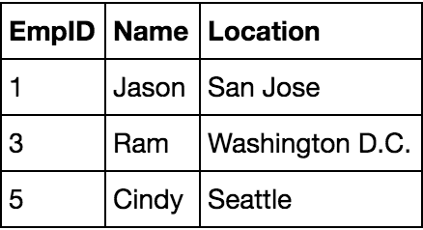
Inner Join
Table name: employees
Table name: locations
Exercise: What will joining employees and locations result in?

Slide 29
Practice with JOIN...ON
Table name: employees
Table name: locations
Exercise: Write SQL that returns a table with EmpID, Name and Location, joined on EmpID
Answer:
SELECT employees.EmpID, employees.Name, locations.Location
FROM employees
JOIN locations ON employees.EmpID = locations.EmpID;

Slide 30
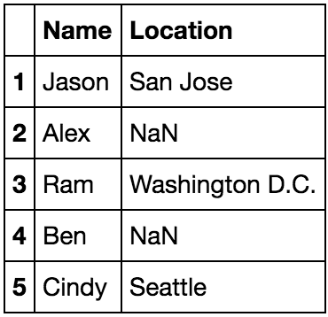

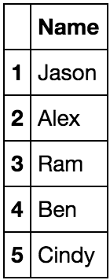
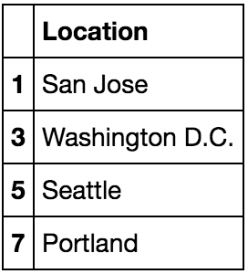
Outer Joins
Takes all values from one of the table’s columns and matches them with whatever overlap there is in the other table.
If you want to pair each name with there they’re from, what would you do?
LEFT
OUTER JOIN
Left
Right

Slide 31
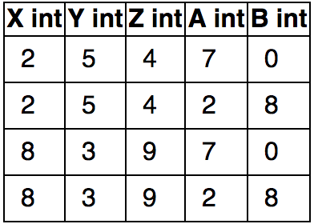
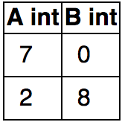
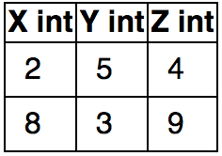
Implicit Join
SELECT *
FROM t1, t2;
Takes and returns all specified overlapping between two tables.
Each row represents the unique combinations of relations from the two sets. In this case, the cross product.
(technically full outer join)
t1:
t2:

Slide 32
Your turn!
You can run SQLite Studio on your own laptop to run queries on databases anytime
Sources for cool datasets
https://www.kaggle.com/datasets
https://www.reddit.com/r/datasets/
Must be in database file format to use in SQLite Studio
Classes: Data 8, CS 186, Data 100, CS 61A
Feedback form: https://tinyurl.com/l4xyljt

Slide 33
Aliases

Slide 34
AS …
Renaming Variables
SELECT date_created AS date FROM Twitter
SELECT t.date_created, r.revenue
FROM Twitter as t, Airplane_revenue as r

Slide 35
WITH… AS ...
Creating Subcontexts
Creates a subquery that you can extract and operate on values from
WITH airlines AS (
SELECT airline, SUM(revenue) as income
FROM Tweets, Revenue
GROUP BY airline)
SELECT airline, income
FROM airlines
WHERE income > 1,000,000

